Slide 1

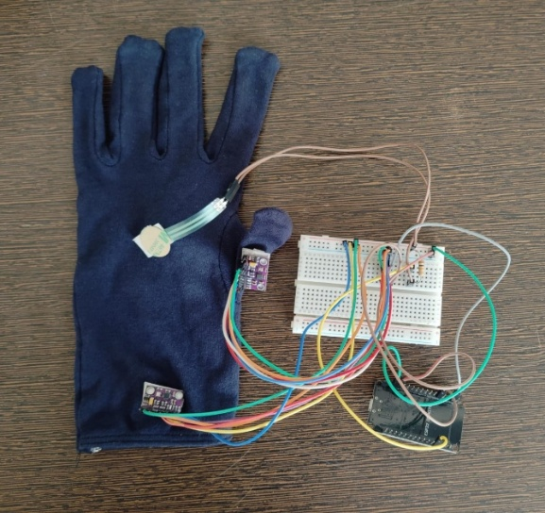
WEARABLE IOT SYSTEM FOR REAL-TIME HAND FATIGUE DETECTION
DURING SMARTPHONE USE
DHANYA S (23MIA1010)
HEMILA SARAVANAN (23MIA1048)
Vellore Institute of Technology Chennai, India, School of Computer Science and Engineering
Abstract
Existing system
Problem identification
Objective
Proposed solution
System architecture
Methodology
Experimental result
Comparison table
Conclusion
References

Slide 2
ABSTRACT
The long usage of the smartphone can lead to the fatigue of the hand, thumb, and wrists because of the repetitive grip force, and incorrect wrists position. The project will describe an IoT based wearable device employed to measure the hand fatigue during the mobile phone use. The proposed system combines a system which operates on the force-sensitive resistors (FSR) sensors on the palm so as to detect the amount of force used to grip an object, and a MPU6500 inertial measurement unit (IMU) to detect the thumb motion and the posture of the wrist. An ESP32 microcontroller constantly reads sensor data, processes it by analyzing it on the microcontroller using a fatigue estimation algorithm which is a set of rules and a simplified algorithm. The system uses sustained grip force, repetitive thumb use and low variation of movement in addition to time in which it is used to determine fatigue risk score in real time. The system also sents a notification message to the user when the fatigue rating exceeds the preset values as a way of persuading the user to tighten the grip, alter wrist- posture or take brief rests. The feedback system will encourage the development of healthier phone usage behavior without visual and audio prompts. All processing is done on the device, and it is possible to achieve a low level of latency response and work without using the cloud services. The suggested system has the capacity to offer an inexpensive, yet efficient means of alerting against the danger of hand fatigue at the earliest stage and introducing ergonomic measures in the long-lasting smartphone utilization by consistent biomechanical-sensing and responsive-tactile-feedback-based control.

Slide 3
EXISTING SYSTEM
Self-Assessment Methods:
Users rely on pain or discomfort, which is subjective and detected too late.
Ergonomic Guidelines & Reminder Apps
Provide generic break reminders without tracking actual hand activity.
Clinical Diagnostic Tools (EMG, Nerve Tests)
Accurate but expensive and not suitable for continuous daily monitoring.
Wearable Devices (Smartwatches)
Track general movement but lack detailed hand and grip force analysis.
Research Prototypes
Limited systems using single sensors without real-time feedback or practical usability.

Slide 4
PROBLEM IDENTIFICATION
Causes
Continuous smartphone usage leads to repetitive thumb motion
Continuous smartphone usage leads to static wrist posture
Continuous smartphone usage leads to excessive grip force
Effects
Causes hand fatigue
Leads to wrist pain
Increases risk of RSI and carpal tunnel syndrome
Research Gap
No real-time, user-friendly fatigue monitoring system available

Slide 5
OBJECTIVE
Design a wearable IoT system for fatigue detection
Monitor:
Grip force
Thumb movement
Wrist posture
Compute fatigue score in real-time
Provide instant user feedback
Ensure:
Low cost
Low latency

Slide 6
PROPOSED SOLUTION
Develop a wearable IoT-based smart glove system
Use FSR and IMU sensors to capture grip force and hand motion
ESP32 processes sensor data in real-time using embedded computation
Apply rule-based model to calculate fatigue score from extracted features
Send real-time alerts to the user via Telegram notification

Slide 7
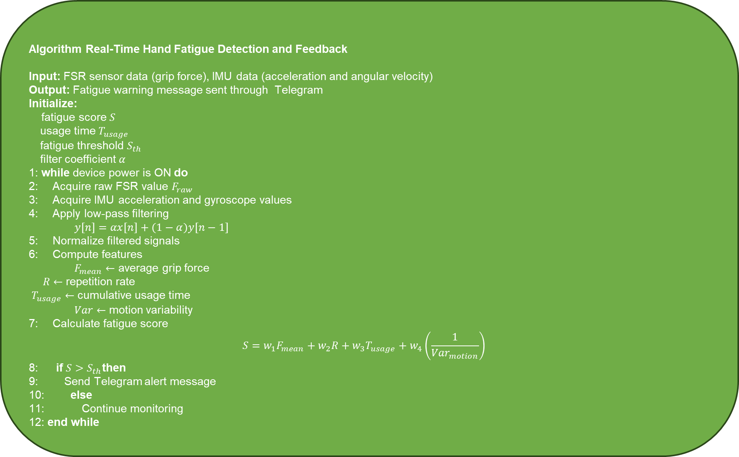
ALGORITHM
Algorithm Real-Time Hand Fatigue Detection and Feedback
Input: FSR sensor data (grip force), IMU data (acceleration and angular velocity)
Output: Fatigue warning message sent through Telegram
Initialize:
fatigue score $S$ usage time $T_{usage}$ fatigue threshold $S_{th}$ filter coefficient $α$
1: while device power is ON do 2: Acquire raw FSR value $F_{raw}$ 3: Acquire IMU acceleration and gyroscope values 4: Apply low-pass filtering $y[n]=αx[n]+(1−α)y[n−1]$ 5: Normalize filtered signals 6: Compute features $F_{mean}←$ average grip force
$R←$ repetition rate
$T_{usage}←$ cumulative usage time $Var←$ motion variability 7: Calculate fatigue score
$$\begin{matrix} & S=w_{1}F_{mean}+w_{2}R+w_{3}T_{usage}+w_{4}\left(\frac{1}{Var_{motion}}\right) & & \end{matrix}$$
8: if $S>S_{th}$then 9: Send Telegram alert message 10: else 11: Continue monitoring 12: end while

Slide 8
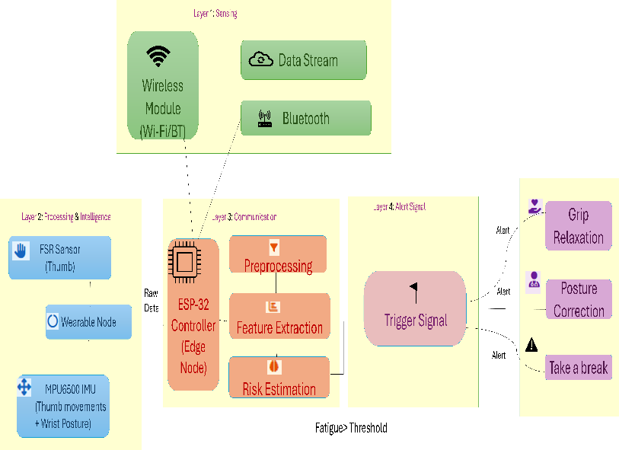
SYSTEM ARCHITECTURE

Slide 9
METHODOLOGY
1. Sensing and Data Acquisition Layer
This layer is responsible for capturing real-time hand activity using wearable sensors integrated into the smart glove. A Force Sensitive Resistor (FSR) measures grip force, while IMU sensors track wrist posture and thumb movements such as scrolling and typing. These sensors continuously collect physiological and motion data without restricting natural smartphone usage. The data is directly transmitted to the embedded processing unit, ensuring accurate, on-body monitoring without relying on external devices.
2. Signal Processing and Fatigue Estimation Layer
In this layer, raw sensor data is cleaned and transformed into meaningful insights. Noise is reduced using low-pass filtering to ensure stable readings, followed by feature extraction such as average grip force, repetition rate, usage duration, and motion variability. These features are combined using a lightweight rule-based model to compute a fatigue score. If the score exceeds a predefined threshold, the system identifies the onset of hand fatigue, enabling fast and efficient real-time analysis without complex machine learning models.
3. Feedback and Communication Layer
This layer delivers real-time feedback to the user based on the detected fatigue level. When the fatigue score crosses the threshold, the system sends an instant alert via Telegram using the ESP32’s built-in WiFi capability. The notification prompts the user to take corrective actions such as relaxing grip, adjusting posture, or taking breaks. This ensures timely intervention, improves user awareness, and promotes healthier smartphone usage habits without requiring additional hardware.

Slide 10
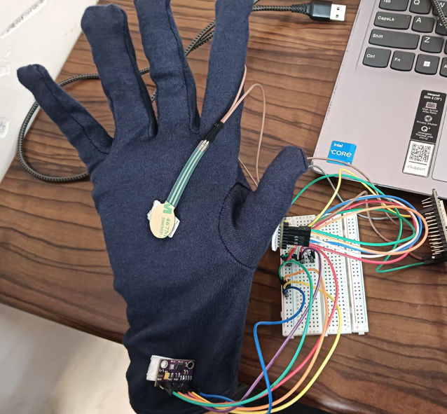
EXPERIMENTAL RESULT
The prototype shown in figure was put through the various conditions of smartphone use, such as normal grip, sustained static holding, repetitive thumb scroll, and sustained non-neutral posture of the wrist. The palm-held FSR sensor had more grip force on prolonged holding, which was a sign of static muscular loading. The wrist MPU6500 detected well the posture measurements on moving off the neutral position, whereas the thumb-mounted MPU6500 recorded the repetitive motion pattern of scrolling. The calculated fatigue score rose steadily as high grip force, relative to persistence of the wrist deviation, and greater repetition of the thumb occurred jointly with the continuous time of use. In the usual usage, the fatigue score had not exceeded the predetermined value and the system state was kept as normal . Under the conditions of combined stress, the fatigue score was over the threshold and a Telegram alert notification was sent successfully. The system was found to be reliable with a USB power supply, as it responded to the alert in less than one second and no false alarms during relaxed conditions.

Slide 11
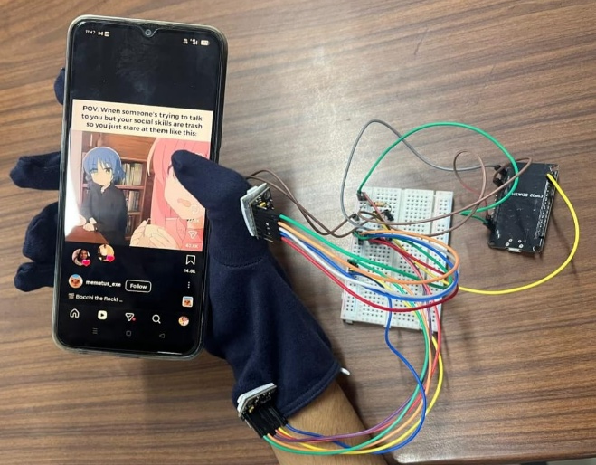
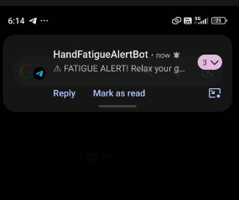
EXPERIMENTAL RESULT

Slide 12
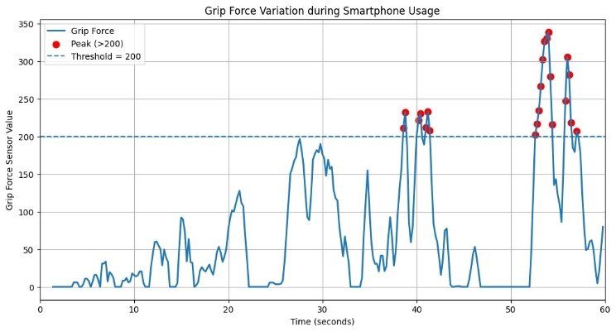
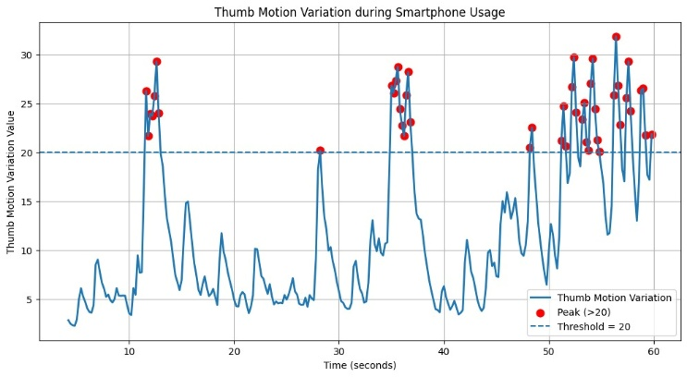
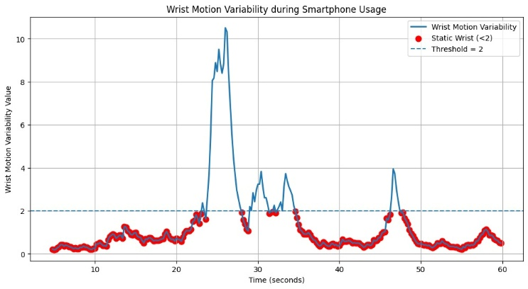
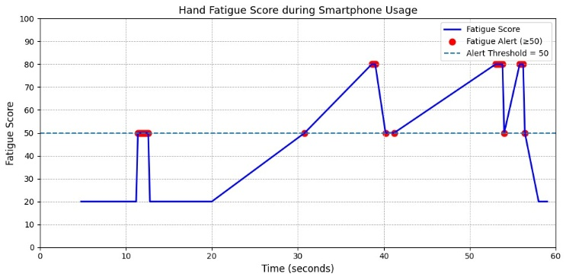
GRAPHICAL ANALYSIS

Slide 13
CONCLUSION
This paper presented a wearable IoT-based system for real-time detection of hand fatigue during prolonged smartphone usage. The proposed device integrates a palm-mounted FSR sensor to measure grip force and an MPU6050 IMU sensor to monitor wrist posture and thumb motion. Sensor data were processed locally using an ESP32 microcontroller, where a fatigue estimation model calculated a fatigue score based on sustained grip force, repetitive thumb movements, and static wrist positions. The experimental results, illustrated through graphical analysis of grip force variation, thumb movement patterns, wrist motion variability, and the overall fatigue score progression, demonstrate the capability of the system to effectively detect fatigue-related conditions during extended smartphone use. All computations were performed on-device, ensuring low latency and eliminating dependence on cloud services. The prototype operated reliably under USB power and maintained stable wireless communication while sending real-time alerts through Telegram whenever the calculated fatigue score exceeded a predefined threshold. The combination of force sensing and inertial motion monitoring improved the reliability of fatigue detection compared to single-sensor approaches, while the graphs provided clear visualization of how sustained strain conditions gradually increase the fatigue score.
Prolonged smartphone usage with excessive grip force, repetitive thumb movement and improper wrist posture can increase the risk of musculoskeletal problems such as repetitive strain injury (RSI), tendon inflammation, wrist strain and early symptoms of carpal tunnel syndrome. By continuously monitoring these parameters, the proposed system can help users recognize unhealthy usage patterns and encourage timely breaks, thereby reducing long-term health risks. Overall, the system provides a low-cost, portable and scalable solution for early hand fatigue detection. Future improvements may include rechargeable battery integration, micro-vibration haptic feedback, miniaturized hardware design and adaptive fatigue models for personalized health monitoring.

Slide 14
REFERENCES
[1] Matteo Musso, Shaoping Bai, Anderson Souza Oliveira, Using a wearable system combining inertial and force sensing for simultaneous detection of limb motion and grasping actions in the workplace, Sensors, 25 (2025). https://doi.org/10.1017/wtc.2025.10026
[2] Dimitrios Miaoulis, Ioannis Stivaros, Stylianos Koubias, Developing a novel muscle fatigue index for wireless sEMG sensors: Metrics and regression models for real-time monitoring, IEEE Sensors Journal, 22 (2025), https://doi.org/10.3390/electronics14112097.
[3] Prabin Sharma, Joanna C. Justus, Megha Thapa , Govinda R. Poudel, Sensors and systems for monitoring mental fatigue: A systematic review, Sensors, 23 (2023), https://doi.org/10.48550/arXiv.2307.01666
[4] Kourosh Kakhia, Senthil Kumar Jagatheesaperumal, Abbas Khosravi, Roohallah Alizadehsani, U. Rajendra Acharya, Fatigue monitoring using wearables and AI: Trends, challenges, and future opportunities, Computers in Biology and Medicine, 171 (2025), https://doi.org/10.1016/j.compbiomed.2025.110461.
[5] Nuno R. A. Martins, Simon Annaheim, Christina M. Spengler, René M. Rossi, Fatigue monitoring through wearables: A state-of-the-art review, Frontiers in Physiology, 13 (2021), https://doi.org/10.3389/fphys.2021.790292.
[6]Thanawat Srichaisak, Akarin Ieochai, Aueawattthanaphisut Aueawattanaphisut, Clinic-oriented feasibility of a sensor-fused wearable for upper-limb function assessment, IEEE Access, 11 (2025).
[7] Zhi Zhi, Qiang Wu, Wearable IoT system for hand function assessment based on EMG signals, Electronics, 11 (2022). https://doi.org/10.3390/electronics13040778
[8] Faeze D. Banadaki, Benyamin Rahimian, Fatemeh Moraveji, Sakineh Varmazyar, The impact of smartphone use duration and posture on the prevalence of hand pain among college students, BMC Musculoskeletal Disorders, 22 (2024).
[9] Sakshi Malhotra, Dr. Jaya Yadav, Dr. Ashok Chopra , Exploring the ergonomic impact of mobile phone screen size on hand fatigue: Insights for user-centered design, Applied Ergonomics,85(2024). https://doi.org/10.5281/zenodo.11203609
[10] Yanfei Xie, Grace Szeto, Jie Dai, Prevalence and risk factors associated with musculoskeletal complaints among users of mobile handheld devices: A systematic review, Applied Ergonomics, 59 (2017)
https://doi.org/10.1016/j.apergo.2016.08.020

Slide 15
REFERENCES
[11] Banadaki, F.D., Rahimian, B., Moraveji, F. et al. The impact of smartphone use duration and posture on the prevalence of hand pain among college students. BMC MusculoskeletDisord 25,574(2024). https://doi.org/10.1186/s12891-024-07685-7
[12] Morteza Jalali Alenjareghi, Firdaous Sekkay, Camelia Dadouchi, Samira Keivanpour, Wearable sensors in Industry 4.0: Preventing work-related musculoskeletal disorders, Sensors International, Volume 7, 2026, 100343, ISSN 2666-3511, https://doi.org/10.1016/j.sintl.2025.100343.
[13] Grazia Iadarola, Alessandro Mengarelli, Sandro Fioretti, Susanna Spinsante, Evaluation of physical effort by IoT-based wearable sensors, Measurement: Sensors, Volume 38, Supplement, 2025, 101648, ISSN 2665-9174, https://doi.org/10.1016/j.measen.2024.101648.
[14] Junjie Chen, Xi Wang, Qiao Li, Bo Shen, Xiaoming Tao,
Wearable multimodal sensing platform for contraction and fatigue transition monitoring of biceps in motion using machine learning, Sensors and Actuators A: Physical, Volume 396, 2025, 117127, ISSN 0924-4247, https://doi.org/10.1016/j.sna.2025.117127.
[15] Anita Gehlot, Rajesh Singh, Sweety Siwach, Shaik Vaseem Akram, Khalid Alsubhi, Aman Singh, Irene Delgado Noya, Sushabhan Choudhury, Real Time Monitoring of Muscle Fatigue with IoT and Wearable Devices, Computers, Materials and Continua, Volume 72, Issue 1, 2022, Pages 999-1015,ISSN1546-2218, https://doi.org/10.32604/cmc.2022.023861.
[16] Phadke, A. N., Harasheh, K., & Gill, S. (2026), Wearable IoT-enabled galvanic skin response device for objective pain and stress monitoring: Hardware design and prototype development. Sensors, 26(1), 116. https://doi.org/10.3390/s26010116.
[17] Hundekari, J. C., Wasnik, S., Paliwal, M., Yadav, I., Kau, C., Badjatiya, B., Kot, L., & Sharma, R. (2025), Effect of duration of exposure of thumb movements while operating mobile phone on nerve conduction velocity and handgrip strength in undergraduate medical students. Journal of Pharmacy and Bioallied Sciences, 17(Suppl. 1), S646–S648. https://doi.org/10.4103/jpbs.jpbs_1774_24
[18] Zhi, Z., & Wu, Q. (2024), Wearable IoT system for hand function assessment based on EMG signals. Electronics, 13(4), 778. https://doi.org/10.3390/electronics13040778
[19] Adão Martins, N. R., Annaheim, S., Spengler, C. M., & Rossi, R. M. (2021). Fatigue monitoring through wearables: A state-of-the-art review. Frontiers in Physiology, 12, Article 790292. https://doi.org/10.3389/fphys.2021.790292
[20] Z. Zhou, C. Yu, X. Zhou, Y. Gao and T. Liu, "Wearable Device Development for Precise Hand Function and Fatigue Assessment Using IMU Sensors," 2024 17th International Congress on Image and Signal Processing, BioMedical Engineering and Informatics (CISP-BMEI), Shanghai, China, 2024, pp. 1-6, doi: 10.1109/CISP-BMEI64163.2024.10906099.

Slide 16
REFERENCES
[
21] Kourosh Kakhi, Senthil Kumar Jagatheesaperumal, Abbas Khosravi, Roohallah Alizadehsani, U. Rajendra Acharya, Fatigue monitoring using wearables and AI: Trends, challenges, and future opportunities, Computers in Biology and Medicine, Volume 195, 2025, 110461, ISSN 0010-4825, https://doi.org/10.1016/j.compbiomed.2025.110461.
[22] Rezaul Karim, Xingzhou Guo, Hongyue Wu, Advancing physical and mental fatigue analysis in construction workers: Insights, technologies, and future directions, Developments in the Built Environment, Volume 24, 2025, 100808, ISSN 2666-1659, https://doi.org/10.1016/j.dibe.2025.100808.
[23] Matteo Musso, Anderson Souza Oliveira, Shaoping Bai, Influence of an upper limb exoskeleton on muscle activity during various construction and manufacturing tasks, Applied Ergonomics, Volume 114,
2024, 104158, ISSN 0003-6870, https://doi.org/10.1016/j.apergo.2023.104158.
[24] Chen, Y., Li, S., Kuang, J., Zhang, X., Zhou, Z., Li, E.-J., Chen, X., & Meng, X. (2026). Biomechanical monitoring of exercise fatigue using wearable devices: A review. Bioengineering, 13(1), 13. https://doi.org/10.3390/bioengineering13010013
[25] Hooman Sarvghadi, Andreas Reinhardt, Esther A. Semmelhack, A survey of wearable devices to capture human factors for human-robot collaboration, Pervasive and Mobile Computing, Volume 110,
2025, 102048, ISSN 1574-1192, https://doi.org/10.1016/j.pmcj.2025.102048.
[26] Oluwaseun Kayode Ajayi, Shengzhi Du, Syeda Nadiah Fatima Nahri, A review of haptic technologies for hardware-in-the-loop development, Sensors and Actuators Reports, Volume 9, 2025, 100331, ISSN 2666-0539, https://doi.org/10.1016/j.snr.2025.100331.
[27] Yi Tang, Jialu Xu, Qiutong Liu, Xiaodan Hu, Wenhao Xue, Zhirui Liu, Ziyi Lin, Hancong Lin, Yili Zhang, Zhuang Zhang, Xuezhi Ma, Jing Wang, Junwen Zhong, Dangxiao Wang, Hanqing Jiang, Yuan Ma,
Advancing haptic interfaces for immersive experiences in the metaverse, Device, Volume 2, Issue 6,
2024, 100365, ISSN 2666-9986, https://doi.org/10.1016/j.device.2024.100365.
[28] Mitar Simić, Goran M. Stojanović, Wearable device for personalized EMG feedback-based treatments, Results in Engineering, Volume 23, 2024, 102472, ISSN 2590-1230, https://doi.org/10.1016/j.rineng.2024.102472.
[29] Qihan Jiang, Maxwell Fordjour Antwi-Afari, Sina Fadaie, Hao-Yang Mi, Shahnawaz Anwer, Jie Liu,
Self-powered wearable Internet of Things sensors for human-machine interfaces: A systematic literature review and science mapping analysis, Nano Energy, Volume 131, Part A, 2024, 110252, ISSN 2211-2855, https://doi.org/10.1016/j.nanoen.2024.110252.
[30] Bazeer Ahamed, Suseela Sellamuthu, Purushotam Naidu Karri, Inumarthi V. Srinivas, A.N. Mohammed Zabeeulla, M. Ashok Kumar, Design of an energy-efficient IOT device-assisted wearable sensor platform for healthcare data management, Measurement: Sensors, Volume 30, 2023, 100928, ISSN 2665-9174, https://doi.org/10.1016/j.measen.2023.100928.

